Slide 1
Artificial intelligence
Session – 10
Date – 09th June, 2022

Slide 2
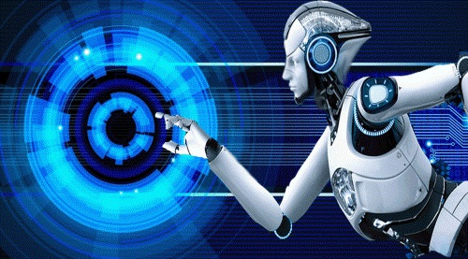
What is Artificial Intelligence?
In today's world, technology is growing very fast, and we are getting in touch with different new technologies day by day.
Here, one of the booming technologies of computer science is Artificial Intelligence which is ready to create a new revolution in the world by making intelligent machines.The Artificial Intelligence is now all around us. It is currently working with a variety of subfields, ranging from general to specific, such as self-driving cars, playing chess, proving theorems, playing music, Painting, etc.
AI is one of the fascinating and universal fields of Computer science which has a great scope in future. AI holds a tendency to cause a machine to work as a human.
Artificial Intelligence is composed of two words Artificial and Intelligence, where Artificial defines "man-made," and intelligence defines "thinking power", hence AI means "a man-made thinking power.“
Artificial Intelligence exists when a machine can have human based skills such as learning, reasoning, and solving problems
With Artificial Intelligence you do not need to preprogram a machine to do some work, despite that you can create a machine with programmed algorithms which can work with own intelligence, and that is the awesomeness of AI.

Slide 3
Why Artificial Intelligence?
Before Learning about Artificial Intelligence, we should know that what is the importance of AI and why should we learn it. Following are some main reasons to learn about AI:
With the help of AI, you can create such software or devices which can solve real-world problems very easily and with accuracy such as health issues, marketing, traffic issues, etc.
With the help of AI, you can create your personal virtual Assistant, such as Cortana, Google Assistant, Siri, etc.
With the help of AI, you can build such Robots which can work in an environment where survival of humans can be at risk.
AI opens a path for other new technologies, new devices, and new Opportunities.

Slide 4
Goals of Artificial Intelligence
Following are the main goals of Artificial Intelligence:
Replicate human intelligence
Solve Knowledge-intensive tasks
An intelligent connection of perception and action
Building a machine which can perform tasks that requires human intelligence such as:
Proving a theorem
Playing chess
Plan some surgical operation
Driving a car in traffic
Creating some system which can exhibit intelligent behavior, learn new things by itself, demonstrate, explain, and can advise to its user.
AD

Slide 5
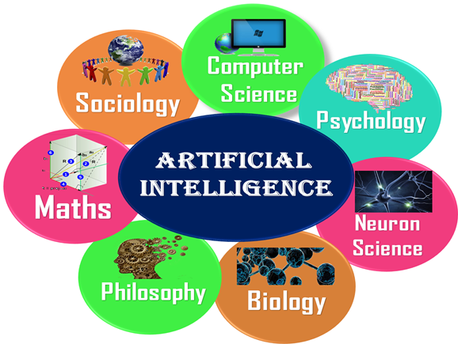
What Comprises to Artificial Intelligence?
Artificial Intelligence is not just a part of computer science even it's so vast and requires lots of other factors which can contribute to it. To create the AI first we should know that how intelligence is composed, so the Intelligence is an intangible part of our brain which is a combination of Reasoning, learning, problem-solving perception, language understanding, etc.
To achieve the above factors for a machine or software Artificial Intelligence requires the following discipline:
Mathematics
Biology
Psychology
Sociology
Computer Science
Neurons Study
Statistics

Slide 6
Advantages of Artificial Intelligence
Following are some main advantages of Artificial Intelligence:
High Accuracy with less errors: AI machines or systems are prone to less errors and high accuracy as it takes decisions as per pre-experience or information.
High-Speed: AI systems can be of very high-speed and fast-decision making, because of that AI systems can beat a chess champion in the Chess game.
High reliability: AI machines are highly reliable and can perform the same action multiple times with high accuracy.
Useful for risky areas: AI machines can be helpful in situations such as defusing a bomb, exploring the ocean floor, where to employ a human can be risky.
Digital Assistant: AI can be very useful to provide digital assistant to the users such as AI technology is currently used by various E-commerce websites to show the products as per customer requirement.
Useful as a public utility: AI can be very useful for public utilities such as a self-driving car which can make our journey safer and hassle-free, facial recognition for security purpose, Natural language processing to communicate with the human in human-language, etc.

Slide 7
Disadvantages of Artificial Intelligence
Every technology has some disadvantages, and thesame goes for Artificial intelligence. Being so advantageous technology still, it has some disadvantages which we need to keep in our mind while creating an AI system. Following are the disadvantages of AI:
High Cost: The hardware and software requirement of AI is very costly as it requires lots of maintenance to meet current world requirements.
Can't think out of the box: Even we are making smarter machines with AI, but still they cannot work out of the box, as the robot will only do that work for which they are trained, or programmed.
No feelings and emotions: AI machines can be an outstanding performer, but still it does not have the feeling so it cannot make any kind of emotional attachment with human, and may sometime be harmful for users if the proper care is not taken.
Increase dependency on machines: With the increment of technology, people are getting more dependent on devices and hence they are losing their mental capabilities.
No Original Creativity: As humans are so creative and can imagine some new ideas but still AI machines cannot beat this power of human intelligence and cannot be creative and imaginative.

Slide 8
MACHINE LEARNING

Slide 9
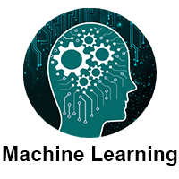
Overview
Machine Learning tutorial provides basic and advanced concepts of machine learning.
Machine learning is a growing technology which enables computers to learn automatically from past data. Machine learning uses various algorithms for building mathematical models and making predictions using historical data or information. Currently, it is being used for various tasks such as image recognition, speech recognition, email filtering, Facebook auto-tagging, recommender system, and many more.
This machine learning tutorial gives you an introduction to machine learning along with the wide range of machine learning techniques such as Supervised, Unsupervised, and Reinforcement learning. You will learn about regression and classification models, clustering methods, hidden Markov models, and various sequential models.

Slide 10























Overview

Slide 11
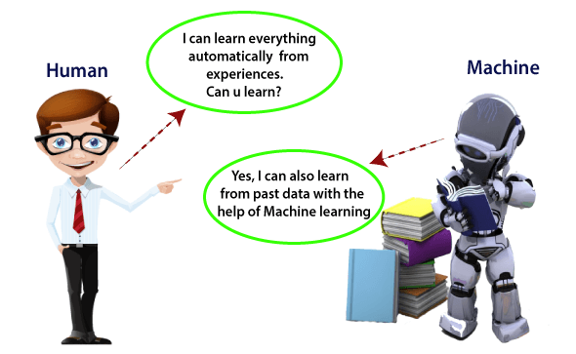
What is Machine Learning?
In the real world, we are surrounded by humans who can learn everything from their experiences with their learning capability, and we have computers or machines which work on our instructions. But can a machine also learn from experiences or past data like a human does? So here comes the role of Machine Learning.
Machine Learning is said as a subset of artificial intelligence that is mainly concerned with the development of algorithms which allow a computer to learn from the data and past experiences on their own. The term machine learning was first introduced by Arthur Samuel in 1959.
With the help of sample historical data, which is known as training data, machine learning algorithms build a mathematical model that helps in making predictions or decisions without being explicitly programmed. Machine learning brings computer science and statistics together for creating predictive models. Machine learning constructs or uses the algorithms that learn from historical data. The more we will provide the information, the higher will be the performance.
A machine has the ability to learn if it can improve its performance by gaining more data.

Slide 12
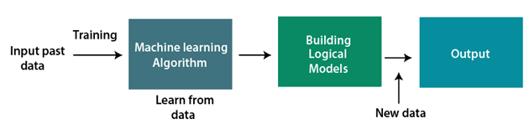
How does Machine Learning works?
A Machine Learning system learns from historical data, builds the prediction models, and whenever it receives new data, predicts the output for it. The accuracy of predicted output depends upon the amount of data, as the huge amount of data helps to build a better model which predicts the output more accurately.
Suppose we have a complex problem, where we need to perform some predictions, so instead of writing a code for it, we just need to feed the data to generic algorithms, and with the help of these algorithms, machine builds the logic as per the data and predict the output. Machine learning has changed our way of thinking about the problem. The below block diagram explains the working of Machine Learning algorithm:

Slide 13
Features of Machine Learning:
Machine learning uses data to detect various patterns in a given dataset.
It can learn from past data and improve automatically.
It is a data-driven technology.
Machine learning is much similar to data mining as it also deals with the huge amount of the data.

Slide 14
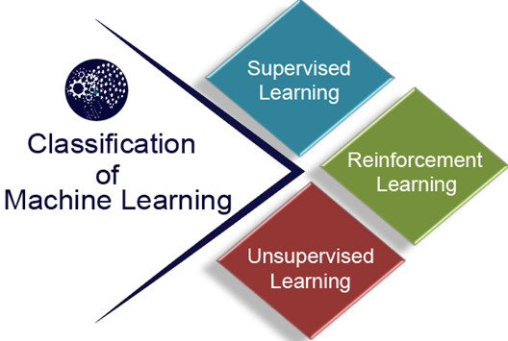
Classification of Machine Learning
At a broad level, machine learning can be classified into three types:
Supervised learning
Unsupervised learning
Reinforcement learning

Slide 15
Supervised Learning
Supervised learning is a type of machine learning method in which we provide sample labeled data to the machine learning system in order to train it, and on that basis, it predicts the output.
The system creates a model using labeled data to understand the datasets and learn about each data, once the training and processing are done then we test the model by providing a sample data to check whether it is predicting the exact output or not.
The goal of supervised learning is to map input data with the output data. The supervised learning is based on supervision, and it is the same as when a student learns things in the supervision of the teacher. The example of supervised learning is spam filtering.
Supervised learning can be grouped further in two categories of algorithms:
Classification
Regression

Slide 16
Unsupervised Learning
Unsupervised learning is a learning method in which a machine learns without any supervision.
The training is provided to the machine with the set of data that has not been labeled, classified, or categorized, and the algorithm needs to act on that data without any supervision. The goal of unsupervised learning is to restructure the input data into new features or a group of objects with similar patterns.
In unsupervised learning, we don't have a predetermined result. The machine tries to find useful insights from the huge amount of data. It can be further classifieds into two categories of algorithms:
Clustering
Association

Slide 17
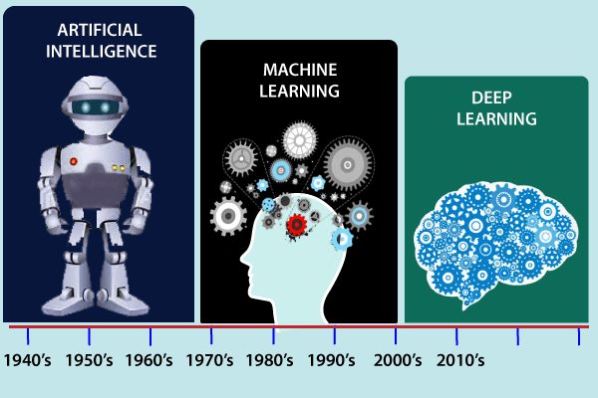
History of Machine Learning
Before some years (about 40-50 years), machine learning was science fiction, but today it is the part of our daily life. Machine learning is making our day to day life easy from self-driving cars to Amazon virtual assistant "Alexa". However, the idea behind machine learning is so old and has a long history. Below some milestones are given which have occurred in the history of machine learning:

Slide 18
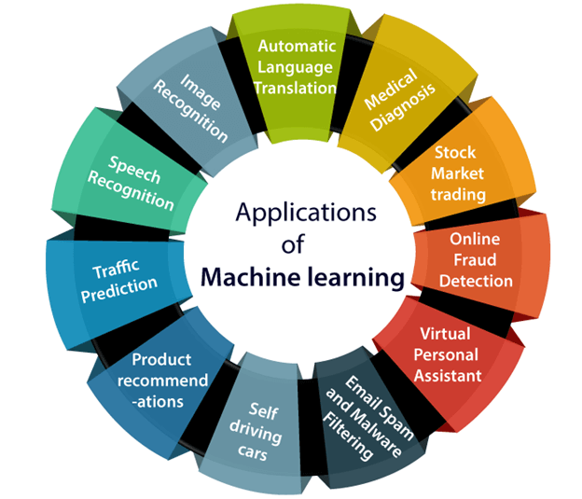
Applications of Machine learning
Machine learning is a buzzword for today's technology, and it is growing very rapidly day by day. We are using machine learning in our daily life even without knowing it such as Google Maps, Google assistant, Alexa, etc. Below are some most trending real-world applications of Machine Learning:

Slide 19
Applications of Machine learning
1. Image Recognition:
Image recognition is one of the most common applications of machine learning. It is used to identify objects, persons, places, digital images, etc. The popular use case of image recognition and face detection is, Automatic friend tagging suggestion:
Facebook provides us a feature of auto friend tagging suggestion. Whenever we upload a photo with our Facebook friends, then we automatically get a tagging suggestion with name, and the technology behind this is machine learning's face detection and recognition algorithm.
It is based on the Facebook project named "Deep Face," which is responsible for face recognition and person identification in the picture.
2. Speech Recognition
While using Google, we get an option of "Search by voice," it comes under speech recognition, and it's a popular application of machine learning.
Speech recognition is a process of converting voice instructions into text, and it is also known as "Speech to text", or "Computer speech recognition." At present, machine learning algorithms are widely used by various applications of speech recognition. Google assistant, Siri, Cortana, and Alexa are using speech recognition technology to follow the voice instructions.
3. Traffic prediction:
If we want to visit a new place, we take help of Google Maps, which shows us the correct path with the shortest route and predicts the traffic conditions.
It predicts the traffic conditions such as whether traffic is cleared, slow-moving, or heavily congested with the help of two ways:
Real Time location of the vehicle form Google Map app and sensors
Average time has taken on past days at the same time.
Everyone who is using Google Map is helping this app to make it better. It takes information from the user and sends back to its database to improve the performance.
4. Product recommendations:
Machine learning is widely used by various e-commerce and entertainment companies such as Amazon, Netflix, etc., for product recommendation to the user. Whenever we search for some product on Amazon, then we started getting an advertisement for the same product while internet surfing on the same browser and this is because of machine learning.
Google understands the user interest using various machine learning algorithms and suggests the product as per customer interest.
As similar, when we use Netflix, we find some recommendations for entertainment series, movies, etc., and this is also done with the help of machine learning.

Slide 20
Applications of Machine learning
5. Self-driving cars:
One of the most exciting applications of machine learning is self-driving cars. Machine learning plays a significant role in self-driving cars. Tesla, the most popular car manufacturing company is working on self-driving car. It is using unsupervised learning method to train the car models to detect people and objects while driving.
6. Email Spam and Malware Filtering:
Whenever we receive a new email, it is filtered automatically as important, normal, and spam. We always receive an important mail in our inbox with the important symbol and spam emails in our spam box, and the technology behind this is Machine learning. Below are some spam filters used by Gmail:
Content Filter
Header filter
General blacklists filter
Rules-based filters
Permission filters
Some machine learning algorithms such as Multi-Layer Perceptron, Decision tree, and Naïve Bayes classifier are used for email spam filtering and malware detection.
7. Virtual Personal Assistant:
We have various virtual personal assistants such as Google assistant, Alexa, Cortana, Siri. As the name suggests, they help us in finding the information using our voice instruction. These assistants can help us in various ways just by our voice instructions such as Play music, call someone, Open an email, Scheduling an appointment, etc.
These virtual assistants use machine learning algorithms as an important part.
These assistant record our voice instructions, send it over the server on a cloud, and decode it using ML algorithms and act accordingly.
8. Online Fraud Detection:
Machine learning is making our online transaction safe and secure by detecting fraud transaction. Whenever we perform some online transaction, there may be various ways that a fraudulent transaction can take place such as fake accounts, fake ids, and steal money in the middle of a transaction. So to detect this, Feed Forward Neural network helps us by checking whether it is a genuine transaction or a fraud transaction.
For each genuine transaction, the output is converted into some hash values, and these values become the input for the next round. For each genuine transaction, there is a specific pattern which gets change for the fraud transaction hence, it detects it and makes our online transactions more secure.

Slide 21
Applications of Machine learning
9. Stock Market trading:
Machine learning is widely used in stock market trading. In the stock market, there is always a risk of up and downs in shares, so for this machine learning's long short term memory neural network is used for the prediction of stock market trends.
10. Medical Diagnosis:
In medical science, machine learning is used for diseases diagnoses. With this, medical technology is growing very fast and able to build 3D models that can predict the exact position of lesions in the brain.
It helps in finding brain tumors and other brain-related diseases easily.
11. Automatic Language Translation:
Nowadays, if we visit a new place and we are not aware of the language then it is not a problem at all, as for this also machine learning helps us by converting the text into our known languages. Google's GNMT (Google Neural Machine Translation) provide this feature, which is a Neural Machine Learning that translates the text into our familiar language, and it called as automatic translation.
The technology behind the automatic translation is a sequence to sequence learning algorithm, which is used with image recognition and translates the text from one language to another language.

Slide 22
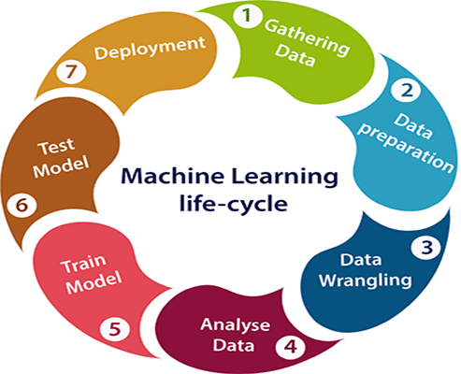
Machine learning Life cycle
Machine learning has given the computer systems the abilities to automatically learn without being explicitly programmed. But how does a machine learning system work? So, it can be described using the life cycle of machine learning. Machine learning life cycle is a cyclic process to build an efficient machine learning project. The main purpose of the life cycle is to find a solution to the problem or project.
Machine learning life cycle involves seven major steps, which are given below:
Gathering Data
Data preparation
Data Wrangling
Analyse Data
Train the model
Test the model
Deployment
The most important thing in the complete process is to understand the problem and to know the purpose of the problem. Therefore, before starting the life cycle, we need to understand the problem because the good result depends on the better understanding of the problem.

Slide 23
Machine learning Life cycle
1. Gathering Data:
Data Gathering is the first step of the machine learning life cycle. The goal of this step is to identify and obtain all data-related problems.
In this step, we need to identify the different data sources, as data can be collected from various sources such as files, database, internet, or mobile devices. It is one of the most important steps of the life cycle. The quantity and quality of the collected data will determine the efficiency of the output. The more will be the data, the more accurate will be the prediction.
This step includes the below tasks:
Identify various data sources
Collect data
Integrate the data obtained from different sources
By performing the above task, we get a coherent set of data, also called as a dataset. It will be used in further steps.

Slide 24
Machine learning Life cycle
2. Data preparation
After collecting the data, we need to prepare it for further steps. Data preparation is a step where we put our data into a suitable place and prepare it to use in our machine learning training.
In this step, first, we put all data together, and then randomize the ordering of data.
This step can be further divided into two processes:
Data exploration: It is used to understand the nature of data that we have to work with. We need to understand the characteristics, format, and quality of data. A better understanding of data leads to an effective outcome. In this, we find Correlations, general trends, and outliers.
Data pre-processing: Now the next step is preprocessing of data for its analysis.

Slide 25
Machine learning Life cycle
3. Data Wrangling
Data wrangling is the process of cleaning and converting raw data into a useable format. It is the process of cleaning the data, selecting the variable to use, and transforming the data in a proper format to make it more suitable for analysis in the next step. It is one of the most important steps of the complete process. Cleaning of data is required to address the quality issues.
It is not necessary that data we have collected is always of our use as some of the data may not be useful. In real-world applications, collected data may have various issues, including:
Missing Values
Duplicate data
Invalid data
Noise
So, we use various filtering techniques to clean the data.
It is mandatory to detect and remove the above issues because it can negatively affect the quality of the outcome.

Slide 26
Machine learning Life cycle
4. Data Analysis
Now the cleaned and prepared data is passed on to the analysis step. This step involves:
Selection of analytical techniques
Building models
Review the result
The aim of this step is to build a machine learning model to analyze the data using various analytical techniques and review the outcome. It starts with the determination of the type of the problems, where we select the machine learning techniques such as Classification, Regression, Cluster analysis, Association, etc. then build the model using prepared data, and evaluate the model.
Hence, in this step, we take the data and use machine learning algorithms to build the model.

Slide 27
Machine learning Life cycle
5. Train Model
Now the next step is to train the model, in this step we train our model to improve its performance for better outcome of the problem.
We use datasets to train the model using various machine learning algorithms. Training a model is required so that it can understand the various patterns, rules, and, features.
6. Test Model
Once our machine learning model has been trained on a given dataset, then we test the model. In this step, we check for the accuracy of our model by providing a test dataset to it.
Testing the model determines the percentage accuracy of the model as per the requirement of project or problem.
7. Deployment
The last step of machine learning life cycle is deployment, where we deploy the model in the real-world system.
If the above-prepared model is producing an accurate result as per our requirement with acceptable speed, then we deploy the model in the real system. But before deploying the project, we will check whether it is improving its performance using available data or not. The deployment phase is similar to making the final report for a project.

Slide 28
Difference between Artificial intelligence and Machine learning
Artificial Intelligence | Machine learning
Artificial intelligence is a technology which enables a machine to simulate human behavior. | Machine learning is a subset of AI which allows a machine to automatically learn from past data without programming explicitly.
The goal of AI is to make a smart computer system like humans to solve complex problems. | The goal of ML is to allow machines to learn from data so that they can give accurate output.
In AI, we make intelligent systems to perform any task like a human. | In ML, we teach machines with data to perform a particular task and give an accurate result.
Machine learning and deep learning are the two main subsets of AI. | Deep learning is a main subset of machine learning.
AI has a very wide range of scope. | Machine learning has a limited scope.
AI is working to create an intelligent system which can perform various complex tasks. | Machine learning is working to create machines that can perform only those specific tasks for which they are trained.
AI system is concerned about maximizing the chances of success. | Machine learning is mainly concerned about accuracy and patterns.
The main applications of AI are Siri, customer support using catboats, Expert System, Online game playing, intelligent humanoid robot, etc. | The main applications of machine learning are Online recommender system, Google search algorithms, Facebook auto friend tagging suggestions, etc.
On the basis of capabilities, AI can be divided into three types, which are, Weak AI, General AI, and Strong AI. | Machine learning can also be divided into mainly three types that are Supervised learning, Unsupervised learning, and Reinforcement learning.
It includes learning, reasoning, and self-correction. | It includes learning and self-correction when introduced with new data.
AI completely deals with Structured, semi-structured, and unstructured data. | Machine learning deals with Structured and semi-structured data.

